Slide 1
The Graduate School Admissions Updates 2016
Anne Lanzit Shirley Fiasconaro
Meg Buckley Holly Becker
Lisa Pane

Slide 2
Updates to Apply Yourself
Apply Yourself contract ending in 2017. Currently in RFP(Requesting Information) stage- looking at all possibilities.
All applications for graduate study at UConn must be submitted using our online application system.
All newly admitted students for Spring 2017 must accept admission by December 16th, 2016. All newly admitted students for Fall 2017 must accept admission by July 28th, 2017.
There is no deadline for Summer admission.
AL

Slide 3
The Graduate School Catalog Changes for Admissions
To study for a graduate degree, a student must be matriculated by The Graduate School before the first (1st) day of classes in their admitted term. All official documents must be received before matriculation can occur.
Graduate students may enroll in two different degree programs only with the permission of advisors in both programs.
http://gradcatalog.uconn.edu/2016/05/20/significant-changes-in-the-2016-2017-uconn-graduate-catalog/
MB

Slide 4
The Graduate School Catalog Changes for Admissions
To ensure academic success, newly admitted students must accept admission one (1) month before the first day of classes for the term when their studies will begin. Students must arrive on campus on or before the first day of classes in their admitted term. Failure to meet these conditions may cause:
A delay in stipend payments and a loss or reduction of tuition waiver benefits for students holding a graduate assistantship and
A delay of enrollment in a degree program until the following semester.
AL

Slide 5
Other Items for Discussion…
All unofficial transcripts including UConn must be uploaded.
How to handle deferrals? Always e-mail us! gradadmissions@uconn.edu
How to handle University Scholars…
How to change enrollment term for students who have not been admitted- cannot be more than 1 year from initial application! Always e-mail us! gradadmissions@uconn.edu
AL

Slide 6
Other Items for Discussion…
Test Scores: Always make sure to check PeopleSoft when they are not listed in Hobsons! (GRE, GMAT, TOEFL, IELTS, PTE)
GRE, GMAT and TOEFL scores are only accepted electronically.
IELTS scores are only accepted with official paper copies.
Denial letter: Per the General Council there will now only be 1 general denial letter for all departments.
AL

Slide 7
Other Items for Discussion…
Behavioral History Review Committee (BHRC): Per the General Council’s instruction- please refer all students to The Graduate School if they see that their application field of study is “in review” or they mention that they have answered “yes” to a BHRC question.
Have them contact Anne Lanzit or Meg Buckley directly:
Anne.Lanzit@uconn.edu
Meg.Buckley@uconn.edu
MB

Slide 8
Admissions FAQs
1.) I cannot find my applicant by searching by his name, how else can I find it?
LP

Slide 9
Admissions FAQs
2.) How do I know if my applicant should have a fee waiver? Who should I tell them to contact to receive it?
http://grad.uconn.edu/prospective-students/applying-to-uconn/fee-waiver-policy/

Slide 10
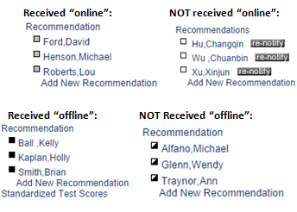
Admissions FAQs
3.) How can I tell if my applicant’s letters of recommendation have been received?
*Offline recommendations received must be entered by the departments, they are not entered by The Graduate School.*
SF

Slide 11
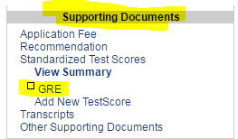
Admissions FAQs
4.) How do I waive letters of recommendation/ have my applicants waive them?
5.) My department does not require GRE scores- how do I waive them?
HB
SF

Slide 12
Admissions FAQs
6.) My applicant’s TOEFL scores should be waived, how can I make sure they are waived?
*Departments should NEVER waive the TOEFL requirement on their own, always contact gradadmissions@uconn.edu. *
http://grad.uconn.edu/wp-content/uploads/sites/1635/2016/06/Revised-Language-Proficiency-Policy-6-7-16.pdf
*DOES NOT APPLY TO SCHOOL OF BUSINESS*
HB

Slide 13
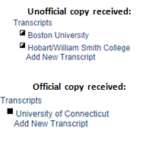
Admissions FAQs
7.) How can I tell if my applicant’s transcripts/ diplomas are received?
*Once an applicant is admitted they must send in their official transcripts for all course work, including classes they are currently enrolled in.*
SF

Slide 14
Admissions FAQs
8.) Does my applicant need to send transcripts if they haven’t received a conferred degree yet?
9.) My International applicant only has original copies of their transcript/ diploma- can they send copies?
Cover Page:
http://grad.uconn.edu/wp-content/uploads/sites/1635/2015/02/InternationalTranscriptsCoverSheet.pdf
10.) What happens when applicants do not send their final official transcripts/ diplomas for courses/ degrees they were enrolled in at the time of application?
SF
MB
SF

Slide 15
Questions?

Slide 16
Admissions FAQs
11.) My International applicant was matriculated- where is their I-20?
12.) What does “ADMT/GREG” in Hobson’s mean?
*Applicants will not be matriculated until they have accepted the offer in Hobson’s, and submitted all required documentation. *
MB
AL

Slide 17
Admissions FAQs
13.) How can I tell if an applicant has accepted enrollment?
AL

Slide 18
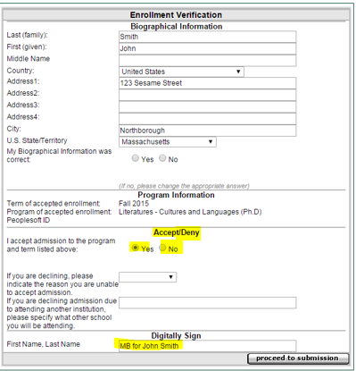
Admissions FAQs
14.) How do I accept or decline enrollment for an applicant?
AL

Slide 19
Admissions FAQs
15.) Why hasn’t my applicant been matriculated?
(ISSS approval for current International UConn graduate students to start new graduate program)
16.) What does “DEIN/ GPAS” in Hobson’s mean?
AL
MB

Slide 20
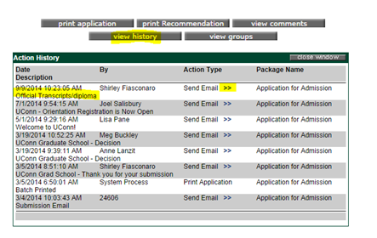
Admissions FAQs
17.) How do I track what my applicant is missing in their application for matriculation when they are “DEIN missing materials”?
SF

Slide 21
Other Questions?

Slide 22
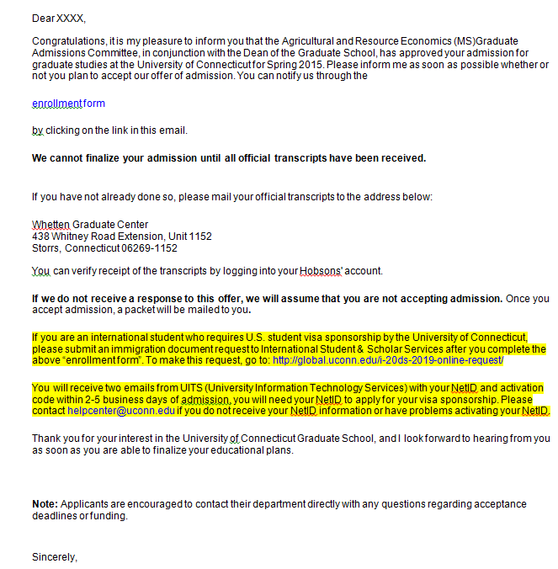
Admission Notice in Application
http://isss.uconn.edu/students/financial-declaration-form/
MB

Slide 23
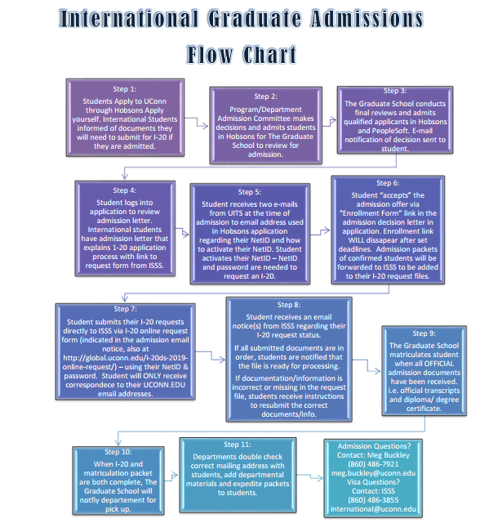
International Admission Procedures
http://grad.uconn.edu/fragrant-fog/wp-content/uploads/Intl-Graduate-Admissions-Flow-Chart-mb-10-8-14.pdf
MB

Slide 24
Information about I-20’s and DS-2019
ISSS office does not produce bulk of I-20’s and DS-2019’s until after commencement in May.
ISSS office works with current AND incoming students. The office is busy with current students on campus up until school year ends.
Departments and students should expect new I-20/ DS-2019 documents for Fall admission to be ready around May and June. (Unless extenuating circumstances.)
MB

Slide 25
Applicant Support
Departmental Resources:
http://grad.uconn.edu/faculty-staff/resources-for-graduate-programs/
Domestic/ Permanent Resident FAQs:
http://grad.uconn.edu/applicant-support/
International Applicant FAQs:
http://grad.uconn.edu/applicant-support/international-applicant-faqs/

Slide 26
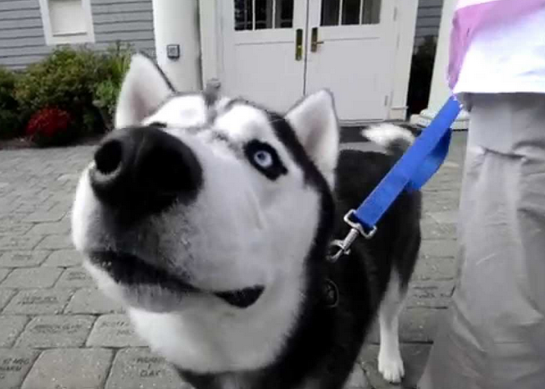
Questions?

