Slide 1
The Graduate School Admissions Updates 2017
Anne Lanzit Shirley Fiasconaro
Meg Drakos Holly Brunette
Lisa Pane

Slide 2
Things you should know…
Hobsons contract has been extended until January 2019.
All applications for graduate study at UConn must be submitted using our online application system.
All newly admitted students for Spring 2018 must accept admission by December 15th, 2017. All newly admitted students for Fall 2018 must accept admission by July 27th, 2018.
AL

Slide 3
Things you should know…
Students must be matriculated before the first (1st) day of class of their admitted term.
There is no deadline for Summer admission.
If an applicant would like to be considered for either the Giolas-Harriott and/or the Crandall-Cordero fellowships, they will be required to submit an essay on the subject in their online application.
AL

Slide 4
Things you should know…
As of 10/14/2017- ETS will offer a “new” paper based (PBT)version of the TOEFL exam, we will continue to accept scores which are sent electronically through ETS for all TOEFL test versions.
Full academic proficiency will not be based on an overall total score for this “new” paper based test (PBT).
There are 3 sections of the test, all 3 sections must meet the minimum scores of:
Listening 22/30
Reading 22/30
Writing 22/30
We will still accept the “old” paper TOEFL (PBT) scores as long as they are still valid (within 2 years old).
MD

Slide 5
Some friendly reminders…
All official documents (transcripts, diplomas/degree certificates) must be received before matriculation can occur.
Graduate students may enroll in two different degree programs only with the permission of advisors in both programs. Matriculation will not occur without notification to The Graduate School from both advisors. This will delay matriculation.
MD

Slide 6
Some friendly reminders…
If the applicant is waiting for their degree to be conferred, have them send their most up-to-date official transcripts for matriculation purposes. They will be required to bring a final official transcript showing completed courses and/or their completed degree as soon as they are available. While the applicant will be able to register for their first term, a hold will be placed on future registration until these materials are received by The Graduate School.
MD

Slide 7
Some friendly reminders…
Spring/Fall applications will always open up for submission on the 10th day of the previous Spring/Fall term.
If a department inactivates a program/ concentration for a term, please contact Lisa Pane to reactivate the program/ concentration for the new term. Lisa.Pane@uconn.edu
LP

Slide 8
Some friendly reminders…
Please always check the effective date of hold on a student’s account. Transcript holds are always future dated.
All graduate students must complete “Not Anymore Training”. An enrollment hold is put on all newly matriculated students, and is removed automatically 2-3 days after they complete the training.
MD

Slide 9
Other Items for Discussion…
All unofficial transcripts including UConn must be uploaded.
How to handle deferrals? Please e-mail us. gradadmissions@uconn.edu
How to handle University Scholars…
How to change enrollment term for students who have not been admitted- cannot be more than 1 year from initial application. Please e-mail us. gradadmissions@uconn.edu
AL

Slide 10
Other Items for Discussion…
Test Scores: Always make sure to check PeopleSoft when they are not listed in Hobsons. (GRE, GMAT, TOEFL, IELTS, PTE)
GRE, GMAT, PTE, and TOEFL scores are only accepted electronically from the official testing service.
IELTS scores are only accepted via paper/scanned copies, we are unable to accept them electronically from IELTS.
Applicants who have been denied by the department are notified by The Graduate School once a week. (Usually Wednesday.)
SF

Slide 11
Other Items for Discussion…
Behavioral History Review Committee (BHRC): Per the General Council’s instruction- please refer all students to The Graduate School if they see that their application field of study is “in review” or they mention that they have answered “yes” to a BHRC question.
Have them contact Anne Lanzit or Meg Drakos directly:
Anne.Lanzit@uconn.edu
Meg.Drakos@uconn.edu
MD

Slide 12
Admissions FAQs
1.) I cannot find my applicant by searching by his name, how else can I find it?
LP

Slide 13
Admissions FAQs
2.) How do I know if my applicant should have a fee waiver? Who should I tell them to contact to receive it?
http://grad.uconn.edu/prospective-students/applying-to-uconn/fee-waiver-policy/
LP

Slide 14
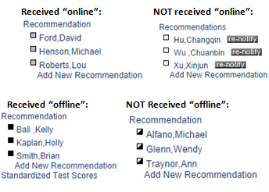
Admissions FAQs
3.) How can I tell if my applicant’s letters of recommendation have been received?
*Offline recommendations received must be entered by the departments, they are not entered by The Graduate School.*
SF

Slide 15
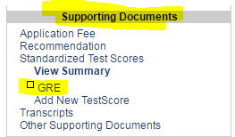
Admissions FAQs
4.) How do I waive letters of recommendation/ have my applicants waive them?
5.) My department does not require GRE scores- how do I waive them?
SF
SF

Slide 16
Admissions FAQs
6.) My applicant’s TOEFL scores should be waived, how can I make sure they are waived?
*Departments should NEVER waive the TOEFL requirement on their own, always contact gradadmissions@uconn.edu. *
http://grad.uconn.edu/wp-content/uploads/sites/1635/2016/06/Revised-Language-Proficiency-Policy-6-7-16.pdf
*DOES NOT APPLY TO SCHOOL OF BUSINESS*
SF

Slide 17
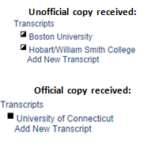
Admissions FAQs
7.) How can I tell if my applicant’s transcripts/ diplomas are received?
*Once an applicant is admitted they must send in their official transcripts for all course work, including classes they are currently enrolled in.*
SF

Slide 18
Admissions FAQs
8.) Does my applicant need to send transcripts if they haven’t received a conferred degree yet?
9.) My International applicant only has original copies of their transcript/ diploma- can they send copies?
Cover Page:
http://grad.uconn.edu/wp-content/uploads/sites/2114/2017/04/International-Transcripts-Cover-Sheet.pdf
10.) What happens when applicants do not send their final official transcripts/ diplomas for courses/ degrees they were enrolled in at the time of application?
SF
MD
SF

Slide 19
Questions?

Slide 20
Admissions FAQs
11.) My International applicant was matriculated- where is their I-20?
12.) What does “ADMT/GREG” in Hobson’s mean?
*Applicants will not be matriculated until they have accepted the offer in Hobson’s, and submitted all required documentation. *
MD
AL

Slide 21
Admissions FAQs
13.) How can I tell if an applicant has accepted enrollment?
AL

Slide 22
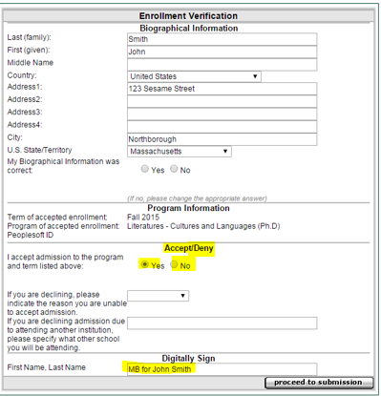
Admissions FAQs
14.) How do I accept or decline enrollment for an applicant?
AL

Slide 23
Admissions FAQs
15.) Why hasn’t my applicant been matriculated?
16.) What does “DEIN/ GPAS” in Hobson’s mean?
AL
MD

Slide 24
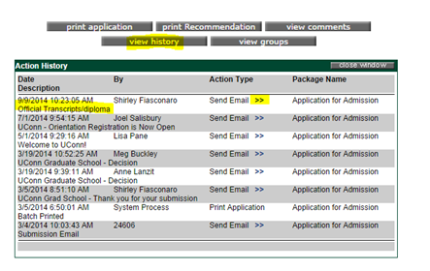
Admissions FAQs
17.) How do I track what my applicant is missing in their application for matriculation when they are “DEIN missing materials”?
SF

Slide 25
Other Questions?

Slide 26
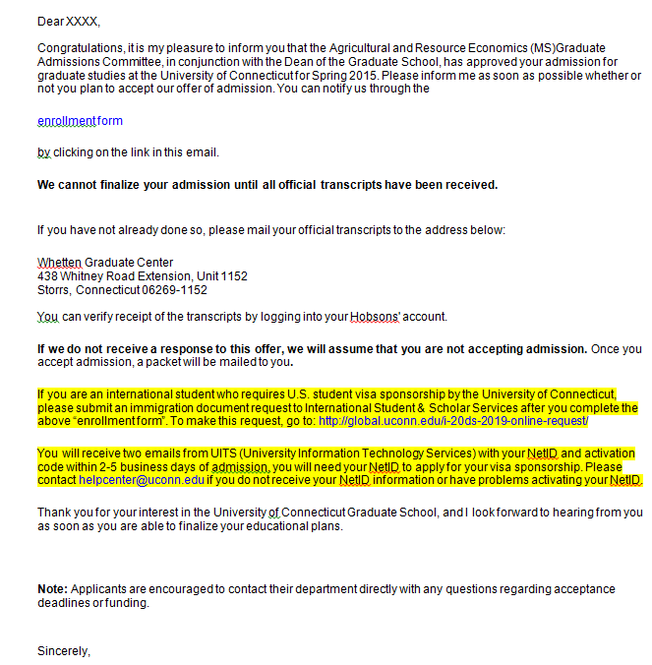
Admission Notice in Application
http://isss.uconn.edu/welcome-start-here/
MD

Slide 27
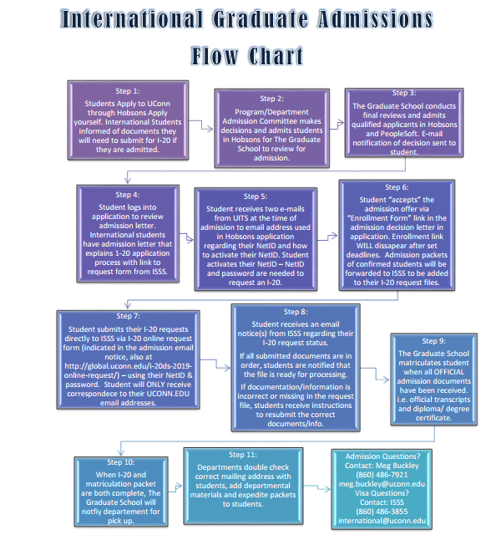
International Admission Procedures
http://grad.uconn.edu/wp-content/uploads/sites/2114/2017/06/New-I-20-Procedures-Fall-14-9-26-2014.ppt
MD

Slide 28
Information about I-20’s and DS-2019
ISSS processes I-20s/DS-2019s as soon as the student’s I-20/ DS-2019 applications are received.
ISSS has a one week processing goal from the time a student’s complete I-20/DS-2019 application is received for a matriculated student.
If I-20/ DS-2019 application is incomplete or student is not matriculated for other reasons at The Graduate School, this process will be delayed.
JK

Slide 29
Applicant Support
Departmental Resources:
http://grad.uconn.edu/faculty/admissions-resources/
Domestic/ Permanent Resident FAQs:
http://grad.uconn.edu/admissions/domestic-faqs/
International Applicant FAQs:
http://grad.uconn.edu/admissions/international-applicant-faqs/

Slide 30
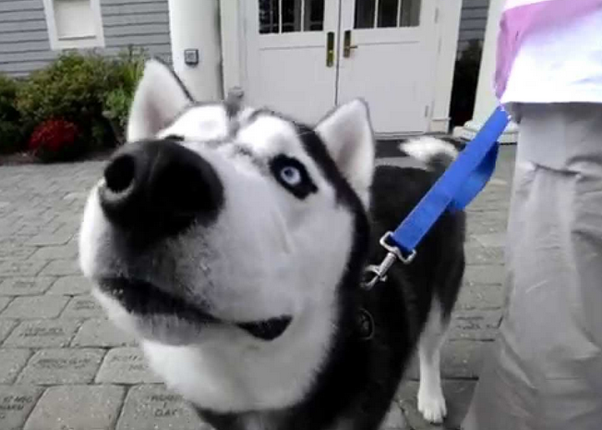
Questions?

