Slide 1
Providing Timely Feedback*
Carl Lejuez
Provost and
Professor, Psychological Sciences
University of Connecticut
*Part of the Timely Topics Series from the UConn Graduate School

Slide 2
Agenda for Today
Key Features of Feedback
Factors Impacting Willingness/Ability to Take/Give Feedback
Examples of the Timely Feedback Process
Gray Area Questions (Break Out Groups)
Domains Checklist for Expectation Setting and Timely Feedback
Resources if You are Stuck
Today’s material:
Focused on faculty/staff mentor and a graduate student completing a mentored milestone project
Is focused on the graduate student in the role of a graduate student, in the context of their:
research (scholarship, creative work/performance, lab work etc);
clinical, service, and other disciplinary-relevant activities; and
other daily interactions with their research group as well as with other faculty, staff, and students.
Does not directly address instructional duties as part of a GTA assignment

Slide 3
A. Key Features of Feedback
Goal-referenced and Expectation Focused
Specific, Detailed, and Actionable
User Friendly
Timely, Consistent, Ongoing, and Updating

Slide 4
1. Goal Referenced/Expectation Focused
Setting clear expectations is the first step in giving feedback
Differences compared to other mentors
Differences compared to other students
Feedback should always start with the “why”
Implications/limitations of the current product/behavior
Implications/limitations of changing or not changing product/behavior
Feedback should separate out intermediary goals/performance from final goals/performance
Shaping vs. Fading

Slide 5
2. Specific, Detailed, and Actionable
Clear examples ensure feedback understanding and generalization
Feedback will be more specific (and easier to hear) if focused on particular behavior without using labels or generalizations
It should be clear to the receiver what they can do differently as a result of the feedback
While it can feel like it’s raising the stakes, walking through what remediation would look like can bring some clarity for the student

Slide 6
3. User Friendly
Consider matching feedback approach with student needs
The environment that you thrived in may not be best for others
Focus on your impressions (less focus on others’ impressions)
Consider how to use positive feedback to soften the impact
Can occur regularly to build confidence
Can occur as a complement to negative feedback to soften the blow
Consider feedback “in-person” before “in-writing” if possible
Personal responsibility-taking can open students to feedback

Slide 7
4. Timely, Consistent, Ongoing, and Updating
Be clear about how you will provide feedback
Value in combo of ad-hoc feedback + planned regular/annual feedback
Frequent, low-stakes feedback can build trust and confidence
Be clear about meeting frequency to review progress & deadlines
Goals/expectations are most effective with timelines and when reviewed/revised on an annual (or otherwise specified) basis
*Research Driven Considerations (See next few slides)
Mental health and performance benefits of timely feedback – Safety Signal Hypothesis
What makes feedback timely – The role of contiguity and contingency

Slide 8
4a. Benefits of Regular Consistent Feedback: The Safety Signal Hypothesis
Explanation of the experiments conducted by Seligman
Implications of danger signals for knowing safety in their absence: The difference between fear and anxiety
Aside from performance, there are long term MH benefits of safety signals even when real danger signals exist

Slide 9
4b. What Makes Feedback Timely: Contiguity vs Contingency
Most are familiar with classical conditioning and Pavlov’s Dog
A stimulus takes on meaning based on its pairing with another stimulus but:
We often believe it is temporal closeness (contiguity) that pairs two things with each other
While closeness in time helps, it is less important than the predictive linkage
Explanation can bridge the temporal distance between a behavior and feedback about that behavior
Good feedback that is delayed for a reasonable period of time is ALWAYS better than immediate feedback done poorly

Slide 10
B. Factors Impacting Willingness/Ability to Take/Give Feedback?
Understand/acknowledge intersectional identities may bring differential biases, discomfort, and misunderstandings
Understand/acknowledge the key power dynamics at work
Be sure to consider why you may be resistant to giving feedback or the student is resistant to taking feedback
Stages of Change
Functional Analysis

Slide 11
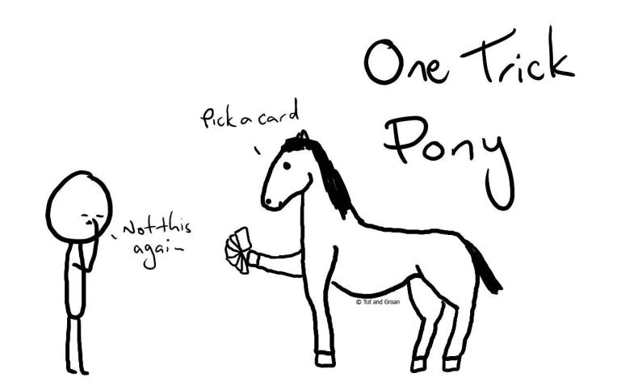

Slide 12
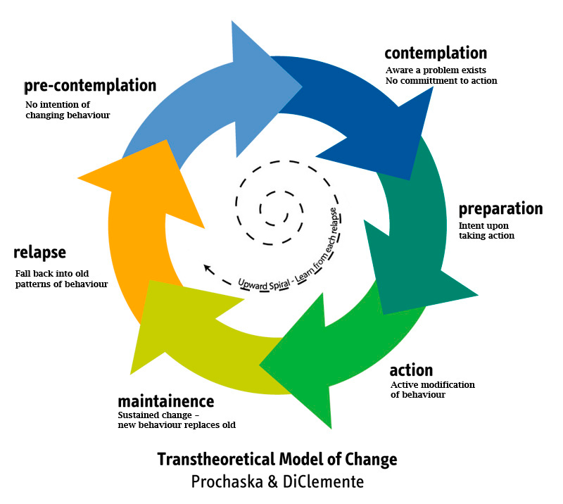
Stages of Change
Let’s revisit the stages of change model from my previous Timely Topics presentation (don’t worry if you missed that)
Are you where you want to be with your timely feedback to students?
Are your students where you want them to be with their acceptance of timely feedback?

Slide 13
Stages of Change
Let’s revisit the stages of change model from my previous Timely Topics presentation (don’t worry if you missed that)
Are you where you want to be with your timely feedback to students?
Are your students where you want them to be with their acceptance of timely feedback?
Next, let’s revisit Why Worksheets (functional analysis) to try and understand why we (and our students) may not be where we want them to be?

Slide 14
Why Worksheet to Understand a Student’s Struggle in Taking Effective Timely Feedback
Trigger (2) Current: Fast approaching deadline Recent: Not getting enough sleep and being pulled in too many directions Early: Early life criticism that leads one to doubt their own ideas | Thoughts (3a) My only chance to pass is to use others’ ideas I’m not really plagiarizing if I change some of the words | Feelings (3b) Fear Overwhelmed Tired
Problem Behavior (1) (START HERE!) Unsatisfactory academic work: Not citing larger literature Plagiarizing Poor interpersonal Interactions: Showing up unprepared for discussions Creating un-inclusive environment | Problem Behavior Positive Consequences (4a) Meet the deadline If plagiarism is undetected, the odds of it being viewed as satisfactory may be higher | Problem Behavior Negative Consequence (4b) All the long-term consequences of “getting caught”
Alternative Approach (5) Complete work earlier and rely only on own ideas | Healthy Behavior Positive Consequences (6a) Less likely to be guilty of plagiarizing | Healthy Behavior Negative Consequence (6b) The ideas may not be “good enough”
Notes:
Go through instructor’s personal example. Elicit suggestions from the class about consequences and alternative healthy behaviors. A goal here is to show that different people will have different healthy behaviors that they deem helpful and acceptable in a given situation. Acknowledge that the healthy behaviors might not feel as gratifying/rewarding as the target behavior, but that, in the long run, they have fewer negative consequences.
If there is time, ask for a student volunteer who might be willing to walk through the steps with the instructor in front of the class.
We will complete the worksheet in the following order
1) Problem behavior 2) Trigger 3) Thoughts 4) Feelings 5) PB Consequences
6) Healthy Behavior 7) HB Consequences

Slide 15
Why Worksheet to Understand a Mentor’s Struggle in Giving Effective Timely Feedback
Trigger (2) Current: Other demands on your time Recent: Not enough sleep Early: Parents punished any efforts to provide feedback to them | Thoughts (3a) This was a good meeting and I don’t want to spoil it by being negative I literally have no idea how to provide feedback in a way that will be useful I’m worried I will not be able to keep my cool when giving feedback | Feelings (3b) Exhausted Anxiety about how it will be received Guilt regarding any of our own shortcomings
Problem Behavior (1) (START HERE!) Feedback is harsh and inconsistent Feedback includes labeling and is often done in public settings Absence of timely feedback | Problem Behavior Positive Consequences (4a) Can stick to good things in the meeting I avoid the potential of making the situation worse | Problem Behavior Negative Consequence (4b) The issues may get worse I will know I didn’t do the right thing for the student
Alternative Approach (5) Try to provide regular positive feedback and consider at each scheduled meeting if there is useful critical feedback I can provide | Healthy Behavior Positive Consequences (6a) I am supporting my student I will be doing something that is hard for me but important for my growth as a mentor | Healthy Behavior Negative Consequence (6b) It will take a lot of effort and it could go wrong
Notes:
Go through instructor’s personal example. Elicit suggestions from the class about consequences and alternative healthy behaviors. A goal here is to show that different people will have different healthy behaviors that they deem helpful and acceptable in a given situation. Acknowledge that the healthy behaviors might not feel as gratifying/rewarding as the target behavior, but that, in the long run, they have fewer negative consequences.
If there is time, ask for a student volunteer who might be willing to walk through the steps with the instructor in front of the class.
We will complete the worksheet in the following order
1) Problem behavior 2) Trigger 3) Thoughts 4) Feelings 5) PB Consequences
6) Healthy Behavior 7) HB Consequences

Slide 16
Sli.do Questions #676971 https://app.sli.do/event/mn2m4bon

Slide 17
C. Examples of the Timely Feedback Process (1/5): Dream Scenario
Several timely notations of positive feedback are provided at ad-hoc times across multiple modalities
Often summarized at scheduled in-person 1:1 meeting
Several timely low stakes notations of an issue are provided in-person at a scheduled 1:1 meeting
Feedback is effectively provided and well-received with a jointly agreed-upon plan for remediation identified
Full remediation is made and documented in a scheduled 1:1 meeting with a follow-up email
Can be a valuable item to include in an annual review***

Slide 18
C. Examples of the Timely Feedback Process (2/5): Two Steps Forward, One Step Back
Several timely notations of positive feedback are provided at ad-hoc times across multiple modalities
Often summarized at scheduled in-person 1:1 meeting
Several timely low stakes notations of an issue are provided in person at a scheduled 1:1 meeting
Feedback well received & works to somewhat but doesn’t generalize to new situations
Future 1:1 meetings:
Identify positive gains
Feedback also provided on the need for the change to generalize, with future problem occurrences linked back to this feedback
Gains/struggles documented in writing and addressed in an annual review

Slide 19
C. Examples of the Timely Feedback Process (3/5): Failure to Launch
Several timely low stakes notations of an issue are provided in person at a scheduled 1:1 meeting
Feedback is effectively provided, but poorly received to extent that no remediation planning is possible
Let student know you will revisit in a future meeting, giving opportunity to receive feedback more effectively
If a subsequent attempt is more effective, move on to remediation planning
If a subsequent attempt is less effective, consider ways to bring in a colleague for a subsequent meeting
Remaining issues should be documented in writing and addressed in further detail in an annual review

Slide 20
C. Examples of the Timely Feedback Process (4/5): Lemonade from Lemons
Feedback about an issue for the 1st time provided in a late-night email or impromptu visit to a student’s office
Feedback is poorly provided, but somehow well-received
Full remediation made, documented in a scheduled 1:1 meeting with follow-up email; documented in annual review
Despite positive results, mentor showed mistakes (results don’t excuse inexcusable behavior especially if we consider the desynchrony across performance and well-being)

Slide 21
C. Examples of the Timely Feedback Process (5/5): Garbage In / Garbage Out
Poor feedback is met with a defensive response
Start over and prepare to re-administer the feedback potentially with a mutually-agreeable colleague present

Slide 22
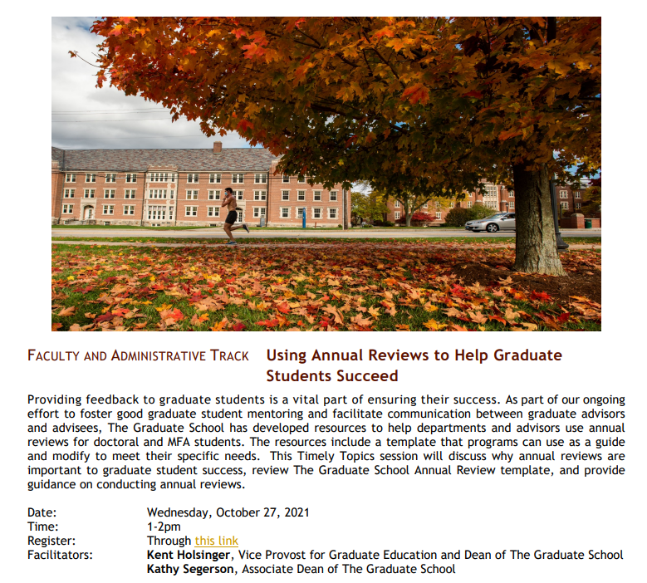
Timely Topics
Using Annual Reviews to Help Graduate Students Succeed
Wednesday, October 27, 2021
1pm-2pm
Register
View All Timely Topics Events

Slide 23
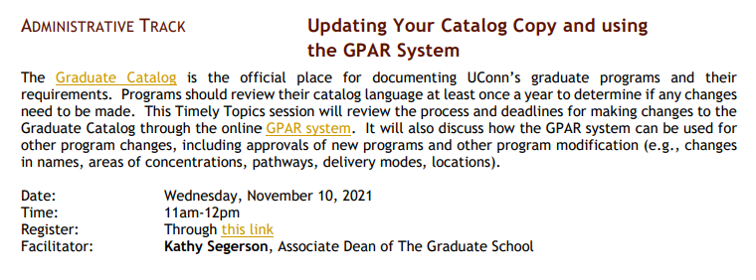
Timely Topics
Updating Your Catalog Copy and Using the GPAR System
Wednesday, November 10, 2021
11am-12pm
Register
View All Timely Topics Events

Slide 24
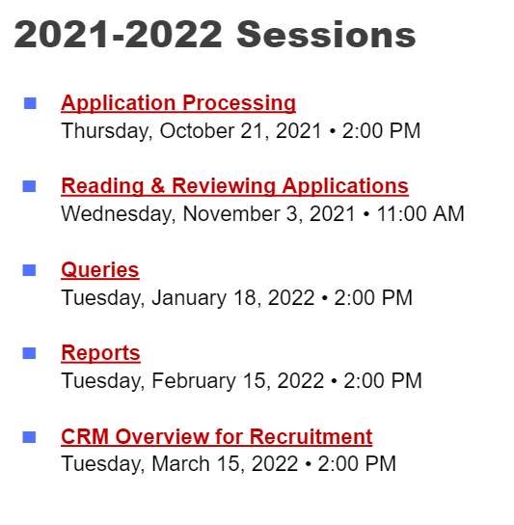
GradSlate Training
GradSlate is The Graduate School’s CRM and admissions software. Learn more about how your department can use it during this year’s GradSlate Training Series.
Register for GradSlate Trainings
Admissions and Recruitment Info

Slide 25
D. Gray Area Questions (1-3)
Should mentee preference impact the feedback process?
- Best-practice vs Stylistic?
To what extent do you find desynchrony among your:
perception of a student’s progress
the feedback you have provided to the student, and
*grades* recorded and/or milestone progress?
What are the implications of a student failing milestones?
Can be part of a developmental process or always a last straw?
Where do we believe the responsibility lies?

Slide 26
D. Gray Area Questions (4-6)
In what ways do disciplinary differences impact best practices?
What are the relative benefits/drawbacks of in-person vs written feedback?
How do you separate out duties under your supervision from other duties such as a GA?

Slide 27
D. Gray Area Questions (7-9)
In what ways do your own mentoring shortcomings impact the feedback you provide to your mentees?
Are you able to provide a student with corrective feedback when you haven’t gotten everything right yourself?
What do you do when a mentee chooses to ignore guidance?
Infrequently and low stakes/stylistic cases
Frequently in significant and meaningful ways
What are the mentoring relationship limits?
Know when you need to step back (you can’t solve everything)
Know when and how to establish boundaries (for own sake and for sake of mentee)
Know when it’s time to refer the student to other support resources

Slide 28
Breakout Conversations on Gray Area Topics Pick 1 and discuss for 10(ish) minutes

Slide 29
E. Domains Checklist for Expectation Setting and Timely Feedback
Communication and Professional Conduct
Academic Development, Mentorship, and Training
Authorship, Publication and Intellectual Property
*Adopted from Ontario Tech Office of Graduate and Postdoctoral Studies

Slide 30
1. Communication and Professional Conduct
Frequency of meetings to review research progress and relevant deadlines, in compliance with program policies
Supervision process (i.e. hands-on/hands-off, mentor/manager/colleague etc.), as well as expectations regarding the student’s office/lab/on-campus attendance
Arrangements to ensure the continuity of supervision during leaves or extended periods of absence
Potential cultural factors that may influence the student's learning, research behavior and experience
Frequency of advisory/supervisory committee meetings (for example, every term), and timing of progress reports and other material to be submitted in advance of scheduled meetings
Student’s awareness of policies, rules and regulations in effect at the university as well as any communications which may be directed to them
Supervisor’s required input when student makes important decisions about their course of study and research
Student’s timely discussion of any foreseen prolonged absence and timing/duration of holidays
Student’s participation in research seminars, training sessions and departmental/lab meetings that the supervisor deems relevant
Self-care*

Slide 31
2. Academic Development, Mentorship, & Training
Completion of assignments/milestones submitted by the student in accordance with agreed-upon schedule to allow adequate assessment
Establishment of the supervisory committees (timelines, composition etc.)
Progress towards completion of degree and the required number of hours carrying out research activities
Participation in professional skill development training offered by the Grad School
Requiring and/or relevant trainings etc to ensure preparation for responsibilities
Training and course(s) required for the student’s study program in compliance with health and safety regulations
Responsibilities regarding ethics approval
Other assignment/activities that are crucial to timely/adequate progress

Slide 32
3. Authorship, Publication, & Intellectual Property
Acknowledgement of the contributions of the student in presentations and published material, in many cases via joint authorship
Clarifying the criteria determining authorship order, and responsibilities for preparing and submitting for publication the results of research completed by the student as part of their degree requirements
Maintaining appropriate confidentiality concerning research activities, in accordance with existing practices and policies of the discipline
Clarifying relevant publication restrictions on the student’s research such as a Non- Disclosure Agreement (NDA)
Involvement in research governed by an Industry-Sponsored Research Agreement
Additional professional experience preferred or discouraged

Slide 33
F. Resources if You are Stuck
Your colleagues and departmental/School leadership
The Graduate School (Cinnamon Adams and Karen Bresciano) support faculty and are available to troubleshoot various situations involving graduate students, including feedback strategies
The Graduate School website has some new tools for both students and faculty that can be helpful for navigating various issues, Including the Annual Academic Review Template. https://grad.uconn.edu/faculty-staff-resources/advising-mentoring/
https://rackham.umich.edu/downloads/how-to-mentor-graduate-students.pdf “How to Mentor Graduate Students”- Rackham Graduate School Univ. of Michigan: Page 13-16 include examples of questions to help develop shared expectations between mentor/mentee in STEM and Social Sciences; Humanities, and for students who are mentored by more than one mentor advisor
https://shared.ontariotechu.ca/shared/faculty/grad/assets/Publications/supervisor-student-conversation/supervisor_conversation_starters.pdf This document provides prompt to set up expectations/communication plan to help develop and promote the advisor/advisee relationship

