Slide 1
The Graduate School’s
Timely Topics Series
Information for
New Graduate Faculty Advisors
Karen L. Bresciano
Assistant Dean
Kathleen Segerson
Associate Dean & Professor of Economics
February 10, 2022

Slide 2
Overview of today’s topics
How does graduate student advising work at UConn? What are the roles and responsibilities of advisors?
What are some tips for being a “good” advisor?
What are some advising challenges and how can you deal with them?
What resources are available to help with advisors?

Slide 3
Things to Keep in Mind
Past: What do you remember (good and/or bad) about your own advisor, and what can you learn from your own experience?
Future: What kind of advisor do you hope to be?

Slide 4
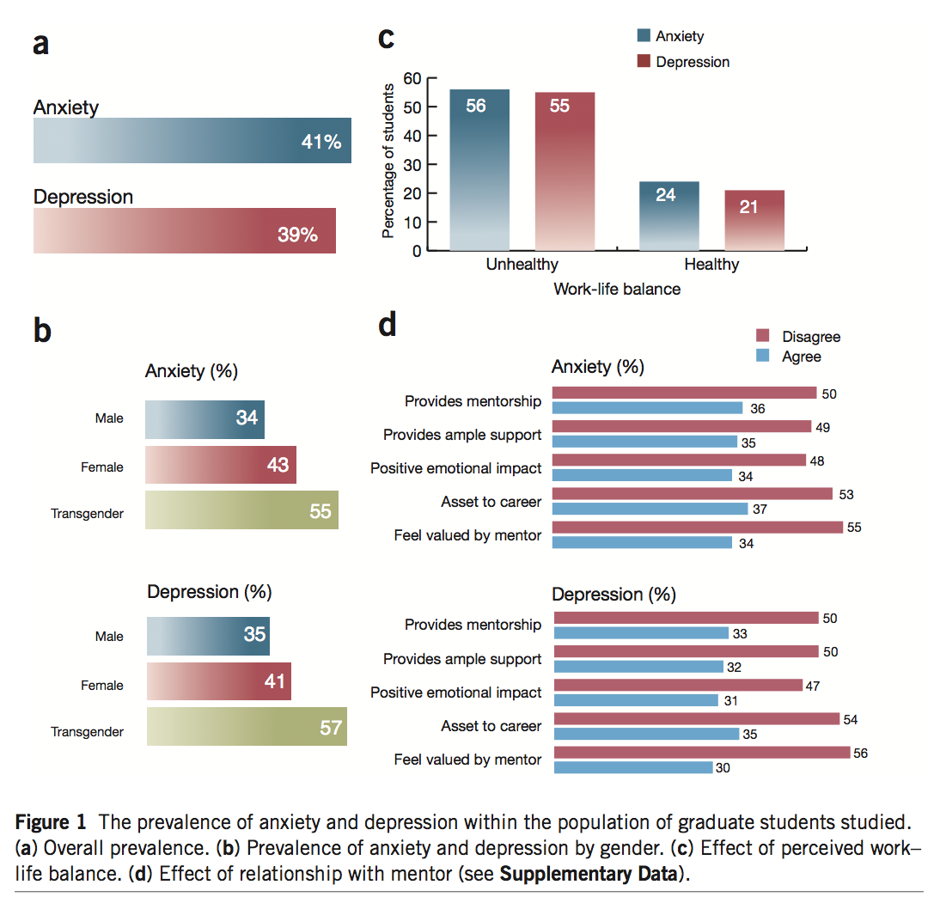
Opportunity for Positive Impact
Evidence for a mental health crisis in graduate education
Teresa M Evans, Lindsay Bira, Jazmin Beltran Gastelum, L Todd Weiss & Nathan L Vanderford
VOLUME 36 NUMBER 3 MARCH 2018 NATURE BIOTECHNOLOGY
Notes:
I show this to you, not to highlight what some are calling a epidemic and crisis in Graduate Education, but rather to emphasize where small efforts can make huge impacts.

Slide 5
Advising at UConn
Every UConn graduate student must have a major advisor (or co-major advisors) who is a member of the Graduate Faculty.
Most also have a 3-4 person advisory committee, chaired by the major advisor.
Some programs have a non-faculty director or other staff person who does most of the advising and acts on behalf of the faculty member who is the designated major advisor
At UConn, major advisor/advisory committee determines when/if a student has met the requirements for a given degree (or certificate), subject to Graduate School (and potentially program-level) minimum requirements.

Slide 6
Degree Requirements
The Graduate School sets minimum degree requirements
Minimum credit requirements (30 for master’s, 30-45 for PhD, including required research credits)
Minimum GPA requirements (3.0)
Allowable credit sharing and transfer credits
Time limits (6 years for master’s, 8 for PhD)
Programs can set additional requirements.
Major advisors/advisory committees can also set requirements for students, as long as they are clearly articulated to students and applied equitably.

Slide 7
Key Forms of Advisor-Student Relationships
In course-based programs:
advisor primarily provides information to students
In research-based programs:
“apprenticeship model”
advisor works closely with student
relationship often evolves from supervision to collaboration

Slide 8
Key Roles and Responsibilities of (Major) Advisors
Information and advice about program completion
Courses to take
Other program requirements
Places to look for information (e.g., graduate catalog, Graduate School, program handbooks, websites)
Research supervision and training
Professional development assistance
Career advice/counseling
Career enhancement opportunities
Approvals (or recommendations) related to academic program
Completion of degree requirements (plans of study, general exams, dissertation defenses, etc.)
Some course-related approvals (e.g., withdrawals, Pass/Fail)
Program interruptions/terminations (e.g., leaves of absence, dismissals)
Advice and referrals to address student needs and concerns

Slide 9
Advisors vs. Mentors
An advisor might or might not not also be a mentor.
A mentor might or might not also be an advisor.
What’s the difference?

Slide 10
Advisors vs. Mentors
Advisors
Student-advisor relationship is more professional
Advisors typically focus primarily on academic progress
Advisors are often chosen or assigned based on expertise or training
Advisors provide advice and can serve as professional role models
Mentors
Student-mentor relationship is more personal
Mentors often focus more on the overall well-being of the student
Mentors are typically chosen based (at least partially) on other (personal) characteristics
Mentors provide advice and can serve as personal role models

Slide 11
Tips for Good Advising/Mentoring
Overarching Tip: Foster meaningful 2-way communication
Communicate clearly, constructively, and regularly
Provide clear, constructive, and regular feedback to students
Seek feedback from students on the effectiveness of communication
Source: https://rackham.umich.edu/downloads/how-to-mentor-graduate-students.pdf

Slide 12
Tips for Good Advising/Mentoring
Expectations
Be transparent about expectations
Academic expectations and standards
Needed training (and where to get it)
Personal and professional boundaries
Academic Success
Set and review milestones, and acknowledge student accomplishments
Look for and create opportunities for students to succeed
Help students learn from mistakes
Encourage students to develop new skills and think critically and independently
Overall Well-being
Be open, approachable, and accessible
Listen to student concerns and respond constructively
Look for and respond to signs of stress/distress, and reach out as appropriate
Source: https://rackham.umich.edu/downloads/how-to-mentor-graduate-students.pdf

Slide 13
Annual Academic Reviews
Annual academic reviews can help advisors and students articulate and document both progress toward degree and expectations going forward.
TGS has developed a template for doing annual reviews for doctoral/MFA students:
https://grad.uconn.edu/faculty-staff-resources/managing-graduate-programs/annual-academic-evaluations/

Slide 14
Possible Advising Challenges
Student is not making adequate academic progress
Not completing coursework
Not progressing adequately on research
Student appears to be suffering from non-academic challenges (e.g., physical/mental health issues, other personal/family issues)
Failure to see “eye-to-eye” or agree on plans moving forward
Difficult inter-personal dynamics between advisor and advisee (personalities play a role in all relationships)
Misunderstandings (typically due to communication issues)

Slide 15
Resources to Help
TGS website: https://grad.uconn.edu/faculty-staff-resources/advising-mentoring/
TGS staff: Graduate Student and Post-Doctoral Student Affairs Team
Karen Bresciano: karen.bresciano@uconn.edu
Cinnamon Adams: cinnamon.adams@uconn.edu
Megan Petsa: megan.petsa@uconn.edu
Stuart Duncan: stuart.duncan@uconn.edu
Things they can help with:
Having difficult conversations
Referrals to other university resources (e.g., mental health, CSD)
Making changes when more is needed

Slide 16
When More is Needed
Reduced course/credit load
Implications for GA, financial aid, visa status
Change of major advisor
Separation
Academic leave of absence
Voluntary exit/change of program
Dismissal
Student Care Team

Slide 17
Dismissal
Criteria for Dismissal
Failure to maintain the minimum cumulative grade point average required by The Graduate School (3.0);
Receiving a grade of “D+,” “D,” “D-,” “F,” or “U” in any course;
If required, failure to satisfy a foreign language requirement for a degree;
Failure of the doctoral General Examination, if one is required;
Failure to produce an acceptable Doctoral Dissertation Proposal, if one is required;
Unsatisfactory performance in any aspect of the research or writing for a required master’s thesis or doctoral dissertation;
Failure of a required final examination for the master’s or doctoral degree; or
Failure to satisfy any other requirement of the student’s graduate degree program.
Dismissal vs Resignation

Slide 18
GA Supervision
Overlapping roles as students and employees
Union Contract for GAs employed at Storrs/regionals (not UCH)
Protected work
Time off (10/semester)
Progressive discipline (Labor Relations)
Alison Cutler (alison.cutler@uconn.edu)
Ask for guidance
Additional resources and referrals for GAs

Slide 19
International Students
Visa status is impacted by enrollment
add/drop
program change
dates of separation
OPT/CPT and I-20 end dates
Ask ISSS for guidance

Slide 20
Please…
Know what you know
and what you don’t know
Know what things are your responsibility
to know
Know who is supposed to know
what you don’t know

Slide 21
It’s not all you…
Center for Career Development
Student Health & Wellness
Counseling & Mental Health
Financial Aid
Office of National Scholarships & Fellowships
Writing Center
Student Care Team
Cultural Centers
International Student & Scholar Services
Center for Students with Disabilities
Registrar
Library
Graduate Student Senate
Assoc of Area Religious Communities
Graduate Employee Union
And more…

Slide 22
And, of course…
The Graduate School
860.486.3617
gradschool@uconn.edu

Slide 23
Upcoming Events – Timely Topics
Timely Topics is a series of opportunities to engage with subject matter experts on topics relevant to those who support and advise graduate students and programs. Every session is available to all UConn faculty and staff. If you have any questions or topic suggestions for the Timely Topics Series, please contact Megan Petsa (megan.petsa@uconn.edu).
Digital Dissertations - How to Embark on Digital Scholarship at the Graduate Level
Thursday, March 24, 2022 at 1:00 pm
Register
Understanding Employment Rules and Opportunities for International Students: CPT, OPT and On Campus Employment
Thursday, April 7, 2022 at 2:00 pm
Register
Supporting Graduate Students in Communication of Their Research Through 3MT
Thursday, April 21, 2022 at 11:00 am
Register

Slide 24
Upcoming Events – GradSlate
GradSlate Training Presentations are a series of conversations and demos focused on a specific aspect The Graduate School’s online application and CRM system, Slate. These events are appropriate for faculty and staff involved in recruitment and admissions to UConn graduate programs. Please join us to get a deeper understanding about a topic, ask your questions, provide feedback, get tips and tricks, and see new features. If you have any questions or topic suggestions, please contact gradslate@uconn.edu.
Reports Tuesday, February 15, 2022 at 2:00 PM Register
CRM Overview Tuesday, March 15, 2022 at 2:00 PM
Register
Intro to GradSlate / Slate for Graduate Admissions
Wednesday, April 6, 2022 at 2:00 PM Register

