Slide 1

Introducing a new diversity fee waiver process
Kent Holsinger Stuart Duncan
Vice Provost for Graduate Education Director of Programming
and Dean of The Graduate School and Diversity Recruitment
kent.holsinger@uconn.edu stuart.duncan@uconn.edu

Slide 2
Two types of diversity fee “waivers”
Program application fee “waiver”
Not a waiver
Program pays application fee on behalf of the applicant
Details of the process discussed at Timely Topics session on 21 September
Diversity fee waiver
A true waiver
The University does not charge the application fee for applicants who receive this waiver

Slide 3
University Mission Statement
Mission And Purposes of The University of Connecticut
Adopted by the Board of Trustees on April 11, 2006 and amended on June 20, 2006
The University of Connecticut is dedicated to excellence demonstrated through national and international recognition. As Connecticut’s public research university, through freedom of academic inquiry and expression, we create and disseminate knowledge by means of scholarly and creative achievements, graduate and professional education, and outreach. Through our focus on teaching and learning, the University helps every student grow intellectually and become a contributing member of the state, national, and world communities. Through research, teaching, service, and outreach, we embrace diversity and cultivate leadership, integrity, and engaged citizenship in our students, faculty, staff, and alumni. As our state’s flagship public university, and as a land and sea grant institution, we promote the health and well-being of Connecticut’s citizens through enhancing the social, economic, cultural and natural environments of the state and beyond.

Slide 4
Message to the University community on the Supreme Court Decisions
“It is essential to UConn’s mission as a public university that we create and maintain a student body in which people of all races, ethnicities, and backgrounds can thrive. Our great challenge now in the wake of these decisions is continuing to build on that vital mission with the tools we still have available to us.”
President Radenka Maric, June 29, 2023

Slide 5
What do the decisions mean for admissions?
Cannot consider the race of an applicant in making a decision to grant or deny admission
Can consider the lived experience of individual applicants
Overcoming hardships, contributions to the community
More on these at Timely Topics session on 16 November
Can engage in targeted marketing and recruitment
Cannot provide "zero-sum" benefits based on race

Slide 6
Targeted marketing and recruitment
Select a target based on conformity to University’s commitment to provide educational opportunities to all
Includes selecting a target based on evidence that a particular community is underserved or disadvantaged in applying for admission to graduate school
May lead to overrepresentation of some racial/ethnic categories, but cannot be based on seeking such overrepresentation
Benefits must be available to all who meet the stated target qualifications, regardless of race or ethnicity
Exercise caution in providing substantial economic benefit, e.g., travel reimbursement

Slide 7
The Graduate School's new diversity fee-waiver program
The Graduate School is introducing a new fee waiver process to support graduate programs seeking to ensure that their applicant pool includes individuals with a wide range of backgrounds and experiences to further UConn's Mission.
With thanks to all the faculty and staff involved at various stages of this project, including: Kate Capshaw, Joseph Golec, Ofer Harel, Dougles Degges, Aida Ghiaei, Mary Ann Amalaradjou, Kumar Venkitanarayanan, Katrease Sharavolli, Christine North, Bryan Southworth, Amanda Masztal, Jill Bouchard, Victoria Smith, Hillary Barigye, Bryan Callender, and Monique Roy.

Slide 8
The Graduate School's new diversity fee-waiver program
For in-person and virtual recruiting events where there are interactions between a staff or faculty member and an applicant
For example:
Faculty member attends a field-specific national conference and meets with potential graduate students at paper sessions, poster sessions, meet & greets etc.
Staff member attends a recruitment-based event and hosts a booth where they meet with potential graduate students.
Dean hosts a virtual recruiting event where staff / faculty follow up one-on-one or one-to-small-group with potential graduate students.
Graduate student attends a virtual recruitment-based event and meets with potential graduate students.

Slide 9
Overview of the process
Department submits
Application
Graduate School awards diversity fee-waiver to select applications
Graduate School builds event in Slate and provides QR code to faculty/staff for event
Faculty / Staff use QR code at event during direct conversations with candidates
Things to consider:
Applications are accepted on a rolling basis; however, Fall is likely to receive a larger number of diversity fee-waivers.
One application per department / program per academic year. Departments should hold an internal review to strategically select the most important future recruiting event for submission to this process.
The caveat to this is if the department has a prior application rejected or a particularly promising new event / recruiting opportunity presents itself after an application has already been submitted.​

Slide 10
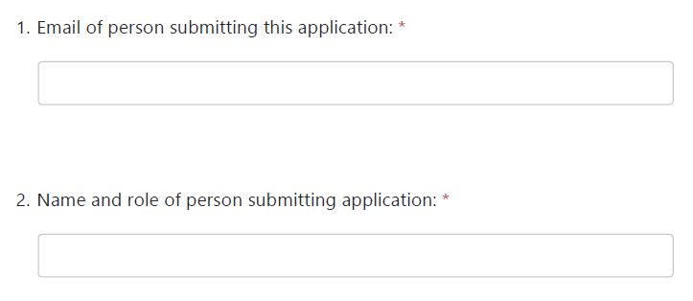
Application
https://forms.office.com/r/QdtsDJmDrn

Slide 11
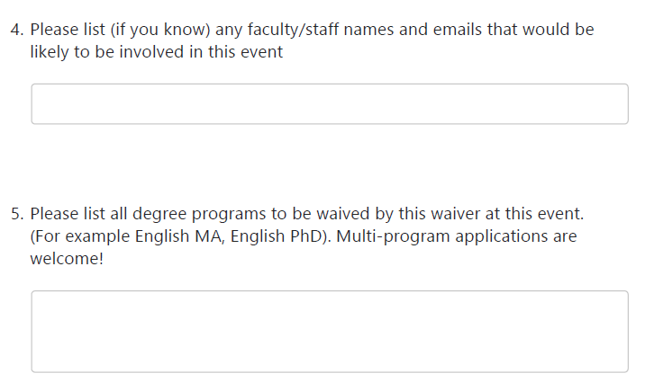
Application
https://forms.office.com/r/QdtsDJmDrn

Slide 12
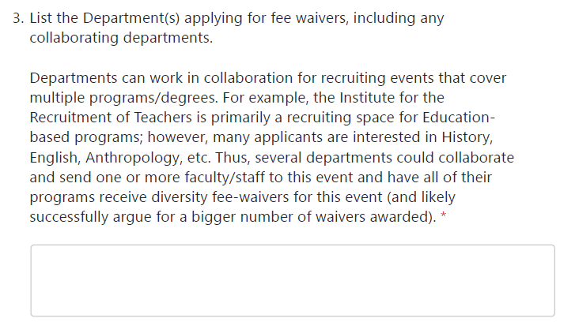
Application
https://forms.office.com/r/QdtsDJmDrn

Slide 13
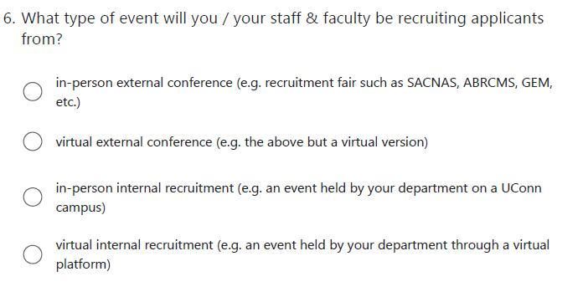
Application
https://forms.office.com/r/QdtsDJmDrn

Slide 14
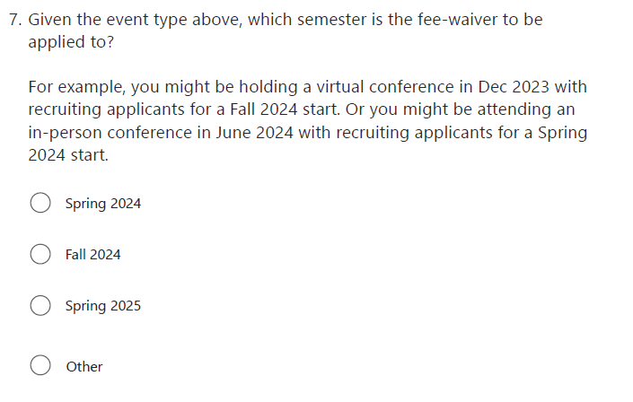
Application .
https://forms.office.com/r/QdtsDJmDrn

Slide 15
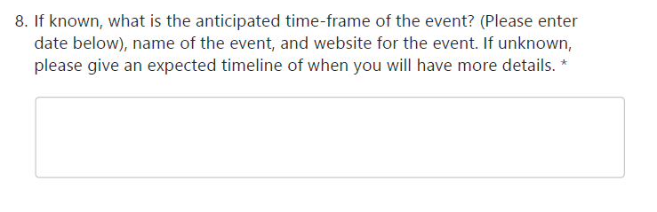
Application
https://forms.office.com/r/QdtsDJmDrn

Slide 16
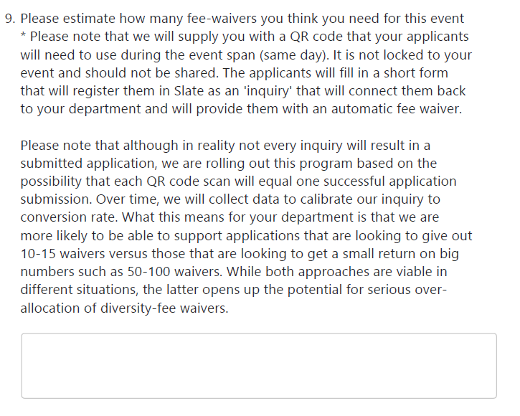
Application Process
https://forms.office.com/r/QdtsDJmDrn

Slide 17
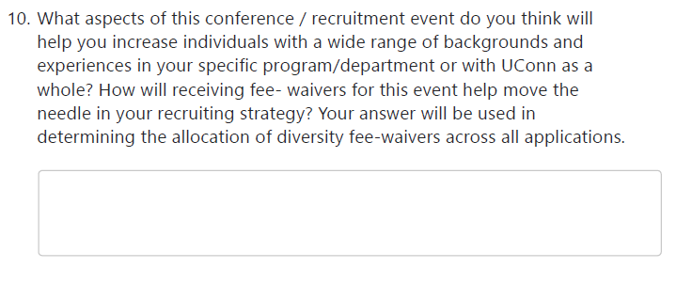
Application Process
https://forms.office.com/r/QdtsDJmDrn

Slide 18
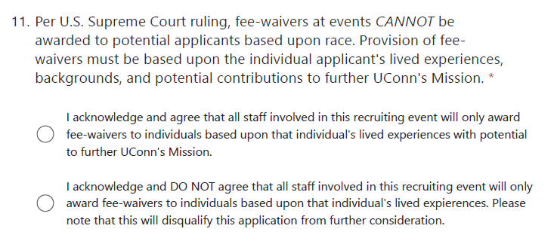
Application Process
https://forms.office.com/r/QdtsDJmDrn

Slide 19
Q&A

